Slide 1

Segmentation
Segmentation is a memory-management scheme that supports programmer view of memory
A logical address space is a collection of segments
A program is a collection of segments. A segment is a logical unit such as:
main program,
procedure,
function,
local variables, global variables,
common block,
stack,
symbol table, arrays

Slide 2
Segmentation
Each segment has a name and a length. The addresses specify both the segment name and the offset within the segment.
The programmer therefore specifies each address by two quantities: a segment name and an offset.
For simplicity of implementation, segments are numbered and are referred to by a segment number, rather than by a segment name.
Thus, a logical address consists of a two tuple:
<segment-number, offset>.

Slide 3
Segmentation
Normally, when a program is compiled, the compiler automatically constructs segments reflecting the input program.
A C compiler might create separate segments for the following:
1. The code
2. Global variables
3. The heap, from which memory is allocated
4. The stacks used by each thread
5. The standard C library

Slide 4
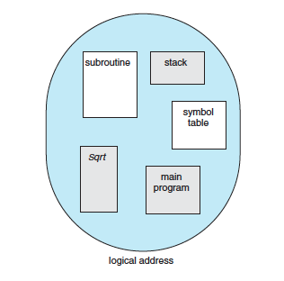
Segmentation
1
1
4
2
3
4
2
3

Slide 5
Segmentation Hardware
Segment table – an implementation to map two-dimensional user-defined addresses into one-dimensional physical address.
Segment base – contains the starting physical address where the segments reside in memory.
Segment limit – specifies the length of the segment.
Segment-table base register (STBR) points to the segment table’s location in memory.
Segment-table length register (STLR) indicates number of segments used by a program;

Slide 6
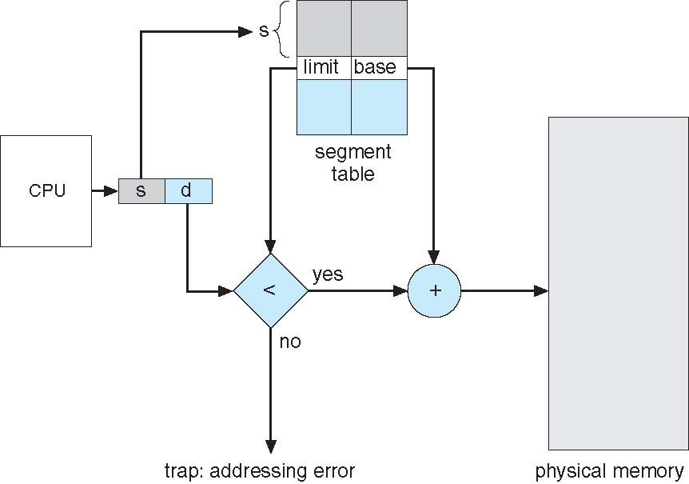
Segmentation Hardware
A logical address consists of two parts:
a segment number, s, and
an offset into that segment, d.
The segment number is used as an index to the segment table.
The offset d of the logical address must be between 0 and the segment limit.
If it is not, we trap to the operating system (logical addressing attempt beyond end of segment).

Slide 7
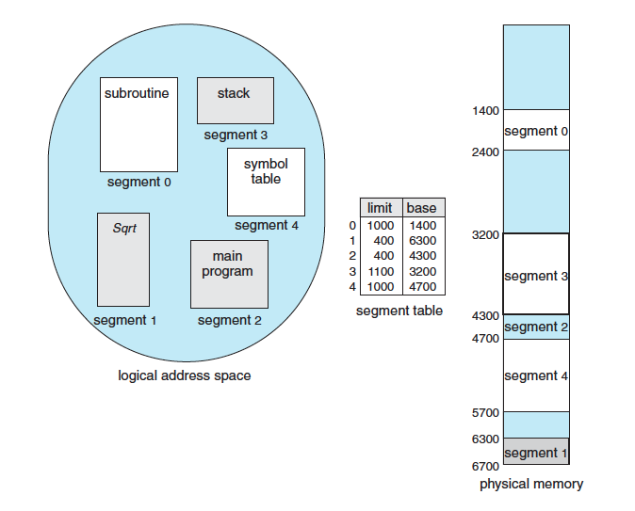
Segmentation
A reference to segment 3, byte 852, is mapped to 3200 (the base of segment 3) + 852 = 4052.
A reference to byte 1222 of segment 0 would result in a trap to the operating system, as this segment is only 1,000 bytes long.
1400+1222=2622

Slide 8
THANK YOU

